Slide 1
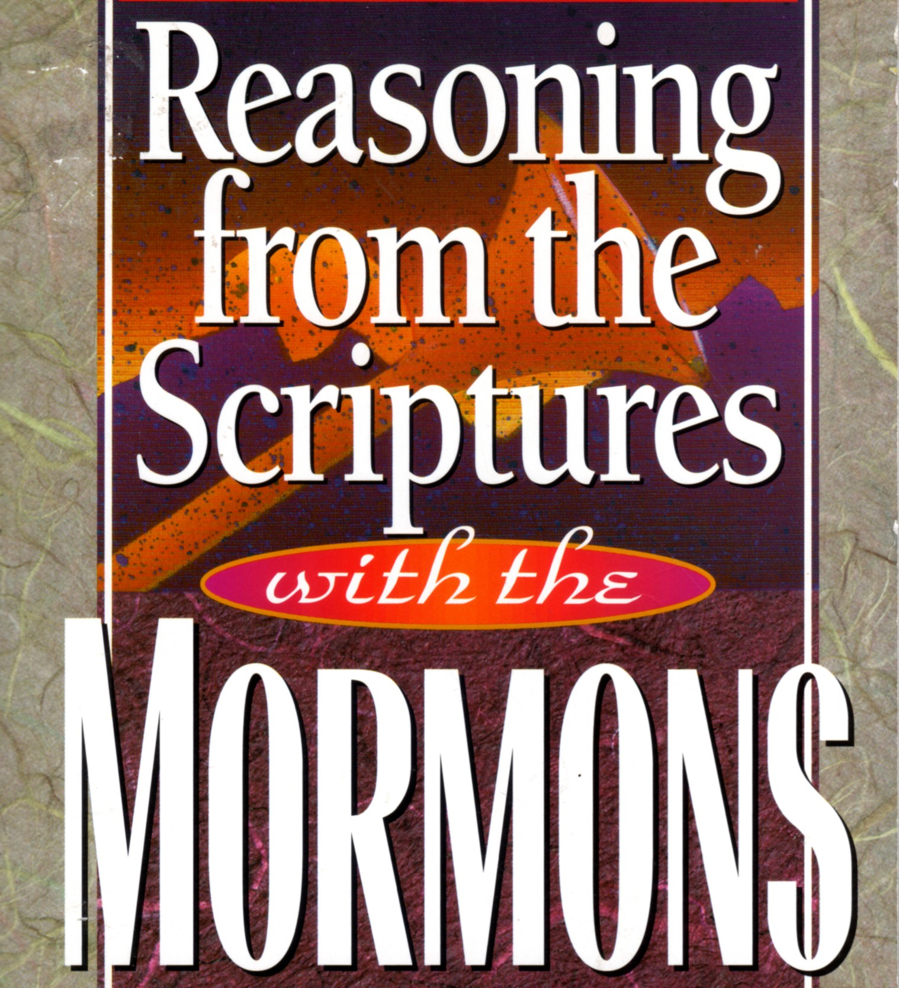

Slide 2
Nothing less than a complete apostasy from the Christian religion would warrant the establishment of the Church of Jesus Christ of Latter-day Saints.
from the introduction in “History of the Church of Jesus Christ of Latter-day Saints”

Slide 3
Adam
Enoch
Noah
Abraham
Moses
the Nephites (the Mormon’s tale of an ancient American civilization)
Jesus and His Apostles

Slide 4
Eisegesis - reading a meaning into the text
Exegesis – drawing a meaning out of the text

Slide 5
…that he may send the Christ appointed for you, Jesus, whom heaven must receive until the time for restoring all the things about which God spoke by the mouth of his holy prophets long ago.
Acts 3:20b-21

Slide 6
And I tell you, you are Peter, and on this rock I will build my church, and the gates of hell shall not prevail against it.
Matthew 16:18
And behold, I am with you always, to the end of the age.
Matthew 28:20

Slide 7
to him be glory in the church and in Christ Jesus throughout all generations, forever and ever
Ephesians 3:21

Slide 8
²⁹ I know that after my departure fierce wolves will come in among you, not sparing the flock; ³⁰ and from among your own selves will arise men speaking twisted things, to draw away the disciples after them. ³¹ Therefore be alert, remembering that for three years I did not cease night or day to admonish every one with tears.
Acts 20:29-31

Slide 9
¹⁷ Now from Miletus he sent to Ephesus and called the elders of the church to come to him. ¹⁸ And when they came to him, he said to them:
“You yourselves know how I lived among you the whole time from the first day that I set foot in Asia, ¹⁹ serving the Lord with all humility and with tears and with trials that happened to me through the plots of the Jews; ²⁰ how I did not shrink from declaring to you anything that was profitable, and teaching you in public and from house to house, ²¹ testifying both to Jews and to Greeks of repentance toward God and of faith in our Lord Jesus Christ. ²² And now, behold, I am going to Jerusalem, constrained by the Spirit, not knowing what will happen to me there, ²³ except that the Holy Spirit testifies to me in every city that imprisonment and afflictions await me. ²⁴ But I do not account my life of any value nor as precious to myself, if only I may finish my course and the ministry that I received from the Lord Jesus, to testify to the gospel of the grace of God. ²⁵ And now, behold, I know that none of you among whom I have gone about proclaiming the kingdom will see my face again. ²⁶ Therefore I testify to you this day that I am innocent of the blood of all, ²⁷ for I did not shrink from declaring to you the whole counsel of God. ²⁸ Pay careful attention to yourselves and to all the flock, in which the Holy Spirit has made you overseers, to care for the church of God, which he obtained with his own blood. ²⁹ I know that after my departure fierce wolves will come in among you, not sparing the flock; ³⁰ and from among your own selves will arise men speaking twisted things, to draw away the disciples after them. ³¹ Therefore be alert, remembering that for three years I did not cease night or day to admonish every one with tears. ³² And now I commend you to God and to the word of his grace, which is able to build you up and to give you the inheritance among all those who are sanctified.
Acts 20:17-32

Slide 10
⁶ I am astonished that you are so quickly deserting him who called you in the grace of Christ and are turning to a different gospel— ⁷ not that there is another one, but there are some who trouble you and want to distort the gospel of Christ. ⁸ But even if we or an angel from heaven should preach to you a gospel contrary to the one we preached to you, let him be accursed.
Galatians 1:6-8

Slide 11
Nothing less than a complete apostasy from the Christian religion would warrant the establishment of the Church of Jesus Christ of Latter-day Saints.
from the introduction in “History of the Church of Jesus Christ of Latter-day Saints”

Slide 12
⁶ Then I saw another angel flying directly overhead, with an eternal gospel to proclaim to those who dwell on earth, to every nation and tribe and language and people. ⁷ And he said with a loud voice, “Fear God and give him glory, because the hour of his judgment has come, and worship him who made heaven and earth, the sea and the springs of water.”
Revelation 14:6-7

Slide 13
[Mormonism] must stand or fall on the story of Joseph Smith. He was either a true prophet of God—divinely called, properly appointed and commissioned —or he was one of the biggest frauds this world has ever seen. There is no middle ground.
Joseph Fielding Smith, “Doctrines of Salvation”

Slide 14
For the Lord God does nothing without revealing his secret to his servants the prophets.
Amos 3:7

Slide 15
Joseph Smith once prophesied that the US government would be overthrown in the 1800s.
Joseph Smith once prophesied that the New Jerusalem would be built in Missouri, during his generation.
Brigham Young once prophesied that the Civil War would fail to end black slavery.
Brigham Young said that both the moon and the sun were inhabited.

Slide 16
¹⁵ and how from childhood you have been acquainted with the sacred writings, which are able to make you wise for salvation through faith in Christ Jesus. ¹⁶ All Scripture is breathed out by God and profitable for teaching, for reproof, for correction, and for training in righteousness, ¹⁷that the man of God may be complete, equipped for every good work.
2 Timothy 3:15-17

Slide 17
And God has appointed in the church first apostles, second prophets, third teachers, then miracles, then gifts of healing, helping, administrating, and various kinds of tongues.
1 Corinthians 12:28

Slide 18
¹⁹ So then you are no longer strangers and aliens, but you are fellow citizens with the saints and members of the household of God, ²⁰ built on the foundation of the apostles and prophets, Christ Jesus himself being the cornerstone, ²¹ in whom the whole structure, being joined together, grows into a holy temple in the Lord.
Ephesians 2:19-21

Slide 19
Joseph Smith’s Changes in Theology and Doctrine
He went from a clear teaching of only one God in the Book of Mormon to an unspecified number of gods in Doctrine and Covenants, and “Gods” in the Book of Abraham (part of the Pearl of Great Price).
He went from teaching that God is a personage of Spirit in the “Lectures on Faith” (lecture five) to teaching that God has a body of flesh and bones in D&C 130:22, and soon thereafter to the teaching that we can become gods ourselves in D&C 132.
He first said David and Solomon’s possession of many wives and concubines was abominable in the Book of Mormon, and then later said that same behavior was justified in D&C.

Slide 20
Brigham Young’s Adam-God Doctrine
This doctrine teaches that Adam (also known as Michael) is God the Father and is literally the father of our premortal spirits, and the literal father of Jesus Christ in the flesh. It was taught by Young on numerous occasions, as shown by early LDS church publications and the private journals of Mormon leaders and eyewitnesses.
Jerald and Sandra Tanner, “Major Problems of Mormonism”, 1989, pp. 61-65.

Slide 21
Brigham Young’s Claims to Authority
I have never yet preached a sermon and sent it out to the children of men, that they may not call Scripture.
I say now, when they [my sermons] are copied and approved by me they are as good Scripture as is couched in this Bible, and if you want to read revelation read the sayings of him who knows the mind of God. Both from “Journal of Discourses”

Slide 22
Now the whole earth had one language and the same words. ² And as people migrated from the east, they found a plain in the land of Shinar and settled there. ³ And they said to one another, “Come, let us make bricks, and burn them thoroughly.” And they had brick for stone, and bitumen for mortar. ⁴ Then they said, “Come, let us build ourselves a city and a tower with its top in the heavens, and let us make a name for ourselves, lest we be dispersed over the face of the whole earth.” ⁵ And the Lord came down to see the city and the tower, which the children of man had built. ⁶ And the Lord said, “Behold, they are one people, and they have all one language, and this is only the beginning of what they will do. And nothing that they propose to do will now be impossible for them. ⁷ Come, let us go down and there confuse their language, so that they may not understand one another's speech.” ⁸ So the Lord dispersed them from there over the face of all the earth, and they left off building the city. ⁹ Therefore its name was called Babel, because there the Lord confused the language of all the earth. And from there the Lord dispersed them over the face of all the earth.
Genesis 11:1-9

Slide 23
He answered, “I was sent only to the lost sheep of the house of Israel.”
Matthew 15:24
⁵ These twelve Jesus sent out, instructing them, “Go nowhere among the Gentiles and enter no town of the Samaritans, ⁶ but go rather to the lost sheep of the house of Israel.
Matthew 10:5-6

Slide 24
And I have other sheep that are not of this fold. I must bring them also, and they will listen to my voice. So there will be one flock, one shepherd.
John 10:16

Slide 25
¹⁷ After his return from the defeat of Chedorlaomer and the kings who were with him, the king of Sodom went out to meet him at the Valley of Shaveh (that is, the King's Valley). ¹⁸ And Melchizedek king of Salem brought out bread and wine. (He was priest of God Most High.) ¹⁹ And he blessed him and said,“Blessed be Abram by God Most High, Possessor of heaven and earth; ²⁰ and blessed be God Most High, who has delivered your enemies into your hand!” And Abram gave him a tenth of everything.
Genesis 14:17-20

Slide 26
²⁰ where Jesus has gone as a forerunner on our behalf, having become a high priest forever after the order of Melchizedek.
Hebrews 6:20

Slide 27
Unto you my fellow servants in the name of Messiah, I confer the Priesthood of Aaron, which holds the keys of the ministering of angels, and of the gospel of repentance, and of baptism by immersion for the remission of sins; and this shall never be taken again from the earth, until the sons of Levi do offer again an offering unto the Lord in righteousness.
D&C 13

Slide 28
In the pre-existent eternity various degrees of valiance and devotion to the truth were exhibited by different groups of our Father’s spirit offspring….
Those who were less valiant in pre-existence and who thereby had certain spiritual restrictions imposed upon them during mortality are known to us as the negroes. Such spirits are sent to earth through the lineage of Cain, the mark put upon him for his rebellion against God and his murder of Abel being a black skin. (Moses 5:16-41; 7:8, 12, 22). Noah’s son Ham married Egyptus, a descendant of Cain, thus preserving the negro lineage through the flood (Abra. 1:2-27).
Bruce McConkie, “Mormon Doctrine”, 1966 edition

Slide 29
Negroes in this life are denied the priesthood; under no circumstances can they hold this delegation of authority from the Almighty. (Abra. 1:20-27) The gospel message of salvation is not carried affirmatively to them (Moses 7:8, 12, 22), although sometimes negroes search out the truth, join the Church, and become by righteous living heirs of the celestial kingdom of heaven…. The present status of the negro rests purely and simply on the foundation of pre-existence. Along with all races and peoples he is receiving here what he merits as a result of the long pre-mortal probation in the presence of the Lord…. The negroes are not equal with other races where the receipt of certain spiritual blessings are concerned, particularly the priesthood and the temple blessings that flow therefrom, but this inequality is not of man's origin. It is the Lord's doing, is based on his eternal laws of justice, and grows out of the lack of spiritual valiance of those concerned in their first estate.
Bruce McConkie, “Mormon Doctrine”, 1966 edition

Slide 30
In all past ages and until recent times in this dispensation, the Lord did not offer the priesthood to the Negroes. However, on June 1, 1978, in the Salt Lake Temple, in the presence of the First Presidency and the Council of the Twelve, President Spencer W. Kimball received a revelation from the Lord directing that the gospel and the priesthood should now go to all men without reference to race or color.
Bruce McConkie, “Mormon Doctrine”, 1978 edition

Slide 31
Bible verses Mormons use for their preexistence theology
Jeremiah 1:5 – the “pre-existence” of Jeremiah
John 17:5 – spirit existence before fleshly existence
Acts 17:28-29 – the “offspring” of God
Romans 8:16-17 – “children” of God

